Slide 1
Advanced OOP

Slide 2

CONTENTS
MVC design pattern - Software division, application framework reuse
Input-output programming
Console, file, database input and output
GUI
Advanced design: six design principles, design patterns

Slide 3
MVC Design Pattern

Slide 4
MVC Pattern
Model— Describes object data and is responsible for its interaction with the database
View — Presents object data and is responsible for interaction with users
Controller — Accept the user request and complete the user request by invoking the model (to process the user request) and the view (to present the user request)
Controller
Update
User request
Notify
Update
Model
View
DB

Slide 5
Input-output programming

Slide 6
Console IO
/** Standard input stream */
private static BufferedReader stdIn =
new BufferedReader(new InputStreamReader(System.in));
/** Standard output stream */
private static PrintWriter stdOut =
new PrintWriter(System.out, true);
/** Standard error stream */
private static PrintWriter stdErr =
new PrintWriter(System.err, true);

Slide 7
Console IO
public static void main(String[] args) throws IOException {
try {
stdOut.println("Please enter the quantity of the product: ");
Integer quantity = Integer.parseInt(stdIn.readLine());
stdOut.println("Product Quantity: " + quantity);
} catch (NumberFormatException nfe) {
stdErr.println("Invalid number format");
}
}

Slide 8
File IO
/** File input stream */
BufferedReader fileIn =
new BufferedReader(new FileReader(filename));
/** File output stream */
PrintWriter fileOut =
new PrintWriter(new FileWriter(filename));
/** File output stream for append */
PrintWriter fileAppend =
new PrintWriter(new FileWriter(filename, true);

Slide 9
/** Create file input stream to read the text file */
BufferedReader fileIn = new BufferedReader(
new FileReader(fileName);
/** Read the file line by line */
String strLine = fileIn.readLine() ;
while( strLine != null) {
System.out.println(strLine);
strLine = fileIn.readLine()
}
/** Close the file input stream */
fileIn.close();
File IO
FileReader(String fileName)

Slide 10
import java.io.*;
public class CopyFile {
private static BufferedReader stdIn = new
BufferedReader(new InputStreamReader(System.in));
private static PrintWriter stdOut =
new PrintWriter( System.out, true);
private static PrintWriter stdErr =
new PrintWriter(System.err, true);
File IO

Slide 11
GUI

Slide 12
User interface: The visual way in which a user interacts with a computer
CLI（Command Line User Interface）
GUI（Graphical User Interface）

Slide 13
Java GUI Libarary
AWT - Abstract Windows Toolkit
AWT package: java.awt.*
Swing - Standard Widget Toolkit，Java 1.2
Swing package: javax.swing.*
http://java.sun.com/docs/books/tutorial/uiswing/

Slide 14
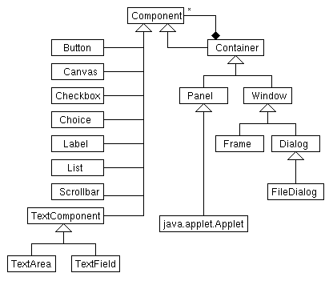
AWT Inheritance diagram
primitive
container

Slide 15
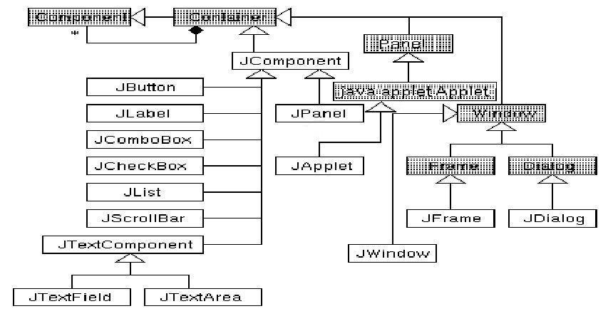
Swing

Slide 16
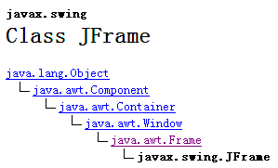
Swing component —— JFrame：Top-Level container
Notes:
JDialog（对话框）和 JApplet（小程序）

Slide 17
JFrame example
Notes:
EXIT_ON_CLOSE（在 JFrame 中定义）：使用 System exit 方法退出应用程序，仅在应用程序中使用。
另外，你还可以使用：
1、HIDE_ON_CLOSE：自动隐藏该窗体；
2、DISPOSE_ON_CLOSE：自动隐藏并释放该窗体。
3、DO_NOTHING_ON_CLOSE：不执行任何操作；
以上均在 WindowConstants 中定义，调用任意已注册 WindowListener 对象的 windowClosing 方法中处理该操作。
默认设置是HIDE_ON_CLOSE，即如果没有设置，点关闭时只是隐藏窗体，在后台进程中还可以看到。

Slide 18
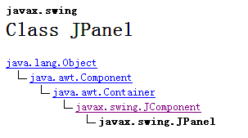
Swing component —— Jpanel, used to place other components

Slide 19
JPanel Example

Slide 20
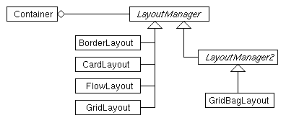
Swing's Layout manager: Automated component layout for window or container components
BorderLayout，Window、Frame、Dialog
FlowLayout，Panel、Applet
GridLayout
CardLayout
GridBagLayout
BoxLayout
SpringLayout
Notes:
Java Swing布局管理器：
https://blog.csdn.net/qq_27870421/article/details/88150242

Slide 21
Swing
—— BorderLayout
5 reigns：
Notes:
边界布局

Slide 22
Swing
—— GridLayout

Slide 23
Swing —— JLable： Label, used to prompt content, display text and ICONS

Slide 24

图形用户接口 GUI 编程
Swing —— JLable：标签，用于提示内容，显示文本和图标
SCU_314064030 面向对象程序设计导论 © Shuhua Ruan

Slide 25
图形用户接口 GUI 编程
Swing —— JLable：标签，用于提示内容，显示文本和图标
SCU_314064030 面向对象程序设计导论 © Shuhua Ruan

Slide 26
Swing —— JLable
SCU_314064030 面向对象程序设计导论 © Shuhua Ruan

Slide 27
Swing —— JButton

Slide 28
图形用户接口 GUI 编程
Swing —— JButton：按钮
不仅可用于显示文本、图标
还能对事件做出响应
SCU_314064030 面向对象程序设计导论 © Shuhua Ruan

Slide 29
JButton
不仅可用于显示文本、图标
还能对事件做出响应
SCU_314064030 面向对象程序设计导论 © Shuhua Ruan

Slide 30
JButton
不仅可用于显示文本、图标
还能对事件做出响应
SCU_314064030 面向对象程序设计导论 © Shuhua Ruan

Slide 31
Swing —— JRadioButton

Slide 32
Swing —— JRadioButton：圆形按钮
可被用户选中或不选中，用户可多选
可以利用 ButtonGroup类将多个圆形按钮组成一组
成组后在某个时刻只能有一个按钮被选中

Slide 33
Swing —— JRadioButton：圆形按钮
可被用户选中或不选中，用户可多选
可以利用 ButtonGroup类将多个圆形按钮组成一组
成组后在某个时刻只能有一个按钮被选中
SCU_314064030 面向对象程序设计导论 © Shuhua Ruan

Slide 34
Swing —— JTextField

Slide 35
Swing —— JTextField：文本字段
可为用户提供一个少量文本的编辑区域
可以设置为是否可编辑
SCU_314064030 面向对象程序设计导论 © Shuhua Ruan

Slide 36
Swing —— JTextArea

Slide 37
Swing —— JTextArea：文本区域
可为用户提供一个多行文本的编辑区域，可设置为是否可编辑
可以用JScrollPane类对象包裹JTextArea对象以设置滚动条
SCU_314064030 面向对象程序设计导论 © Shuhua Ruan

Slide 38
Swing —— JList

Slide 39
Swing —— JList：列表
允许用户从一个列表中选择一个或多个元素
可以用JScrollPane类对象包裹JList对象以设置滚动条

Slide 40
Swing Event process
Act that Results in the Event | Listener Type
User clicks a button, presses Enter while typing in a text field, or chooses a menu item | ActionListener
User closes a frame (main window) | WindowListener
User presses a mouse button while the cursor is over a component | MouseListener
User moves the mouse over a component | MouseMotionListener
Component becomes visible | ComponentListener
Component gets the keyboard focus | FocusListener
Table or list selection changes | ListSelectionListener
Any property in a component changes such as the text on a label | PropertyChangeListener

Slide 41
Swing Event handling: Catch events and handle them accordingly
2. Event
3. Produces an event object and is captured by an event listener
Event listener （Inner Class）
—— process event
Event source（Component）
1. Register to event source

Slide 42
—— ActionListener
ActionListener
For example: class ListenerOne implements ActionListener
Registers an event listener object with one or more component objects
For example: component.addActionListener(new ListenerOne());
ActionListener realize actionPerformed
For example: public void actionPerformed(ActionEvent event)

Slide 43
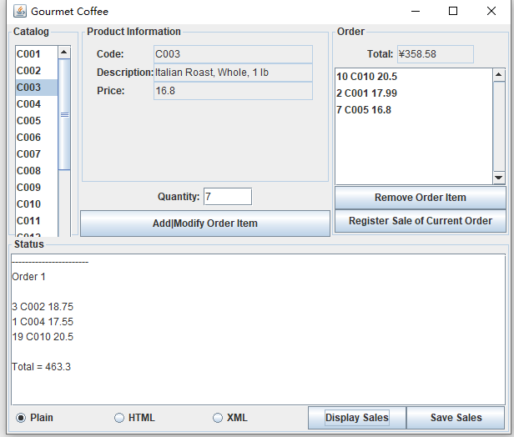
Gourmet Coffee System with GUI

Slide 44
Advanced design

Slide 45
Single Responsibility Principle -SRP
Open-Closed Principle -OCP
Liskov Substitution Principle -LSP
Dependence Inversion Principle -DIP
Interface Segregation Principle -ISP
Law of Demeter -LOD

Slide 46
Single Responsibility Principle -SRP
There should never be more than one reason for a class or a method to change.
—— The most basic object-oriented design principle: Encapsulate classes Make the entity's responsibilities as single and clear as possible: easy to reuse and responsive to change
Notes:
最基本的面向对象的设计原则：体现类的封装性
尽量使实体职责单一、清晰：方便复用，并应对变更

Slide 47
Open-Closed Principle -OCP
Software entities(modules, classes, functions, etc.)
open for extension
but closed for modification
—— The most important object-oriented design principle: software quality goals, instance abstraction
Notes:
最重要的面向对象的设计原则：软件质量目标，体现实体抽象性

Slide 48
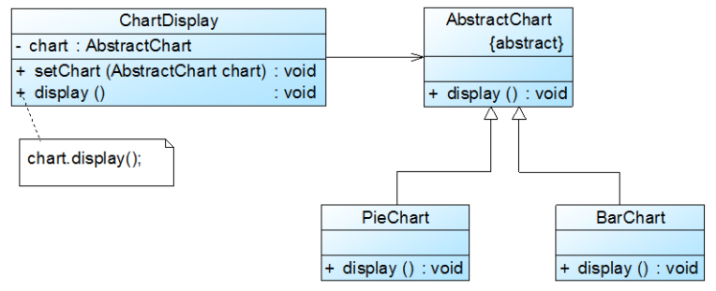
Open-Closed Principle -OCP
Using the setChart() method
Set the concrete "Chart object"
Notes:
通过使用setChart()方法
设置“具体的Chart对象

Slide 49
Liskov Substitution Principle -LSP
Functions that use references to base classes must be able to use objects of derived classes without knowing it. The subtype of one type can appear anywhere the base class appears.
Notes:
“透明地”使用子类
“开闭原则”的实现基础：子类对抽象化有不同的具体实现
通俗表达：子类可以出现在父类出现的任何地方

Slide 50
Dependence Inversion Principle -DIP
High level modules should not depend upon low level modules. Both should depend upon abstractions.
Abstractions should not depend upon details.
Details should depend upon abstractions.
Notes:
“开闭原则”的实现手段：“代码”规范
“代码”从依赖具象（也就是实现类、具体类）倒置为依赖抽象（也就是接口或抽象类），尽量贯彻面向接口、抽象类的编程，以减少类间耦合。

Slide 51
Interface Segregation Principle -ISP
The dependency of one class to another one should depend on the smallest possible interface.
The interface should include the methods as little as possible.
Notes:
接口尽量细化，建立包含尽量少的抽象方法的接口

Slide 52
Law of Demeter -LOD
or Least Knowledge Principle -LKP
Each unit should only talk to immediate friends; don't talk to strangers.
Notes:
迪米特法则来自于1987年美国东北大学(Northeastern University)一个名为“Demeter”的研究项目
一个类只和直接交流的类打交道 —— 高内聚低耦合

Slide 53
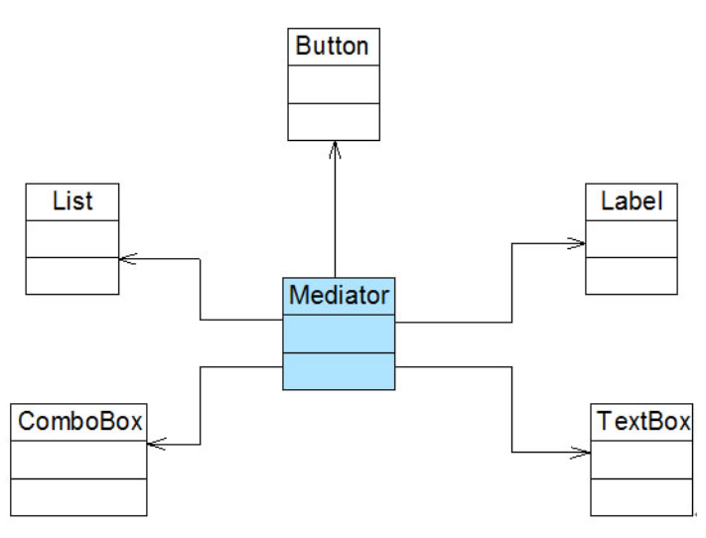
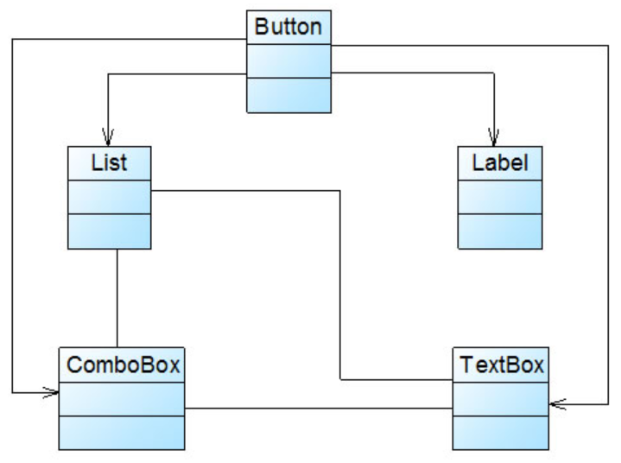
Law of Demeter -LOD
Notes:
迪米特法则来自于1987年美国东北大学(Northeastern University)一个名为“Demeter”的研究项目

Slide 54
Design Pattern

Slide 55
Design patterns
What are design patterns?
Best practices for recurring common problems in software development
Why are design patterns needed?
Each design pattern describes a recurring problem;
And provide a best solution to this problem;
Each mode has its corresponding principle, which is the experience summary of repeated practice.
Better code reuse, reliability, maintainability, extensibility, and readability.
Notes:
设计模式
什么是设计模式？
针对软件开发中反复出现的常见问题的最佳实践方案
为什么需要设计模式？
每种设计模式描述一个不断重复发生的问题，
并针对该问题提供一个最佳解决方案；
每种模式都有相应的原理，是反复实践的经验总结；
代码重用性、可靠性、维护性、扩展性和易读性更好。

Slide 56
Each design pattern has four aspects:
A pattern name
A description of the problem that the pattern addresses
A description of the solution (for instance: class structure)
A discussion of the consequences of using the pattern
Notes:
针对的问题
解决方案
使用情况的讨论

Slide 57
Singleton Pattern
Strategy Pattern
Simple Factory Pattern
Factory Method Pattern
Abstract Factory Pattern
Decorator Pattern
Observer Pattern
Notes:
单例模式
策略模式
简单工厂模式
工厂方法模式
抽象工厂模式
装饰模式
观察者模式

Slide 58
Singleton Pattern
only one instance of a class is created and
provides a method to access that one instance
Singleton
-singletonInstance : Singleton
-Singleton() +getSingletonInstance() : Singleton
- static variable
Constructor is private
static methods
Notes:
类自己创建唯一实例
并提供获取该实例的方法

Slide 59
public class Singleton {
private static Singleton singletonInstance;
private Singleton() { }
public static Singleton getSingletonInstance() {
if (singletonInstance == null) {
singletonInstance = new Singleton();
}
return singletonInstance;
}
}
Singleton
-singletonInstance : Singleton
-Singleton() +getSingletonInstance() : Singleton
- static variable
Constructor is private
static methods
Notes:
延迟实例化，多线程不安全，可能无法保证真正的单例化，可以通过加锁实现多线程安全，保证真正的单例化：
public static synchronized Singleton getSingletonInstance() {
if (instance == null) {
singletonInstance = new Singleton();
}
return singletonInstance;
}

Slide 60
public class Singleton {
private static Singleton singletonInstance;
private Singleton() { }
public static synchronized Singleton getSingletonInstance() {
if (singletonInstance == null) {
singletonInstance = new Singleton();
}
return singletonInstance;
}
}
Singleton
-singletonInstance : Singleton
-Singleton() +getSingletonInstance() : Singleton
- static variable
Constructor is private
static methods
Notes:
延迟实例化，多线程不安全，可能无法保证真正的单例化，可以通过加锁实现多线程安全，保证真正的单例化：
public static synchronized Singleton getSingletonInstance() {
if (instance == null) {
singletonInstance = new Singleton();
}
return singletonInstance;
}

Slide 61
高级类设计
SCUInfo
-scuInfo : SCUInfo -name: String -address: String -telephone: String
-SCUInfo() +getSCUInfo() : SCUInfo +getName():String +getAddress(): String +getTelephone(): String
Notes:
提前实例化，多线程安全

Slide 62
高级类设计
SCUInfo
-scuInfo : SCUInfo -name: String -address: String -telephone: String
-SCUInfo() +getSCUInfo() : SCUInfo +getName():String +getAddress(): String +getTelephone(): String

Slide 63
Stratege Pattern
Define a family of algorithms,
Encapsulate each one and make them interchangeable.
Strategy lets the algorithm vary independently from
the clients that use it.
Notes:
策略模式使得算法独立于使用它的客户端

Slide 64
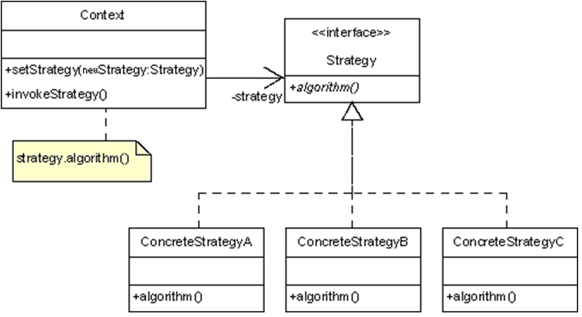

Slide 65
public interface Strategy {
algorithm();
}
public class ConcreteStrategyA implements Strategy {
public void algorithm() { …… }
}
public class ConcreteStrategyB implements Strategy {
public void algorithm() { …… }
}
public class ConcreteStrategyC implements Strategy {
public void algorithm() { …… }
}

Slide 66
public class Context {
private Strategy strategy;
public void setStrategy(Strategy newStrategy) {
strategy = newStrategy;
}
public void invokeStrategy() {
strategy.algorithm();
}
}

Slide 67
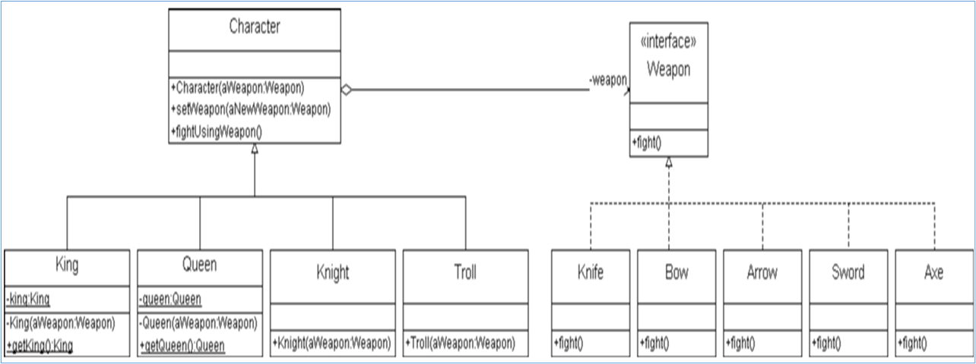
Character

Slide 68
